Slide 1
Translation from Unstructured Meshes to Combinatorial Geometry for Nuclear Energy
Dimitri Kalinichenko
Mentor: Prof. April Novak

Slide 2
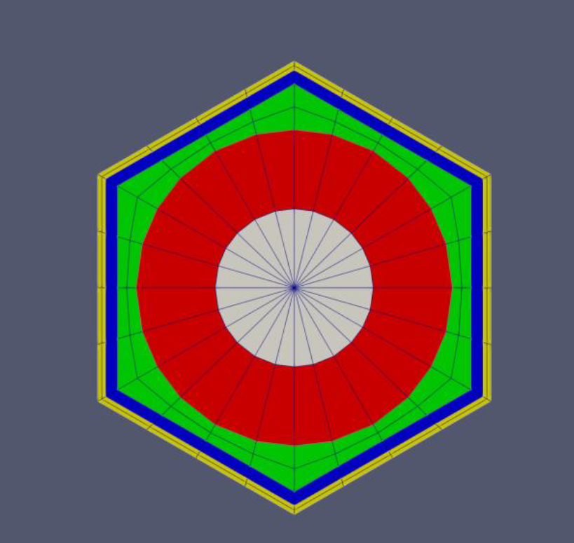

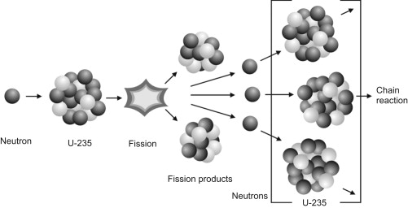
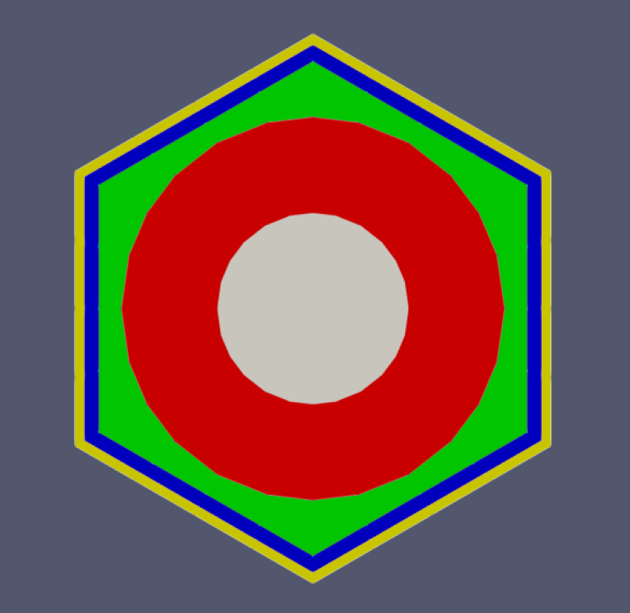

Project Motivation
Neutron behavior is important for nuclear reactor design
Drive nuclear reaction
To accurately model neutrons, need two different programs
[1] M. Gill, F. Livens and A. Peakman, "Chapter 9 - Nuclear Fission," in Future Energy, 2014, pp. 181-198.

Slide 3
Project Challenges

Slide 4
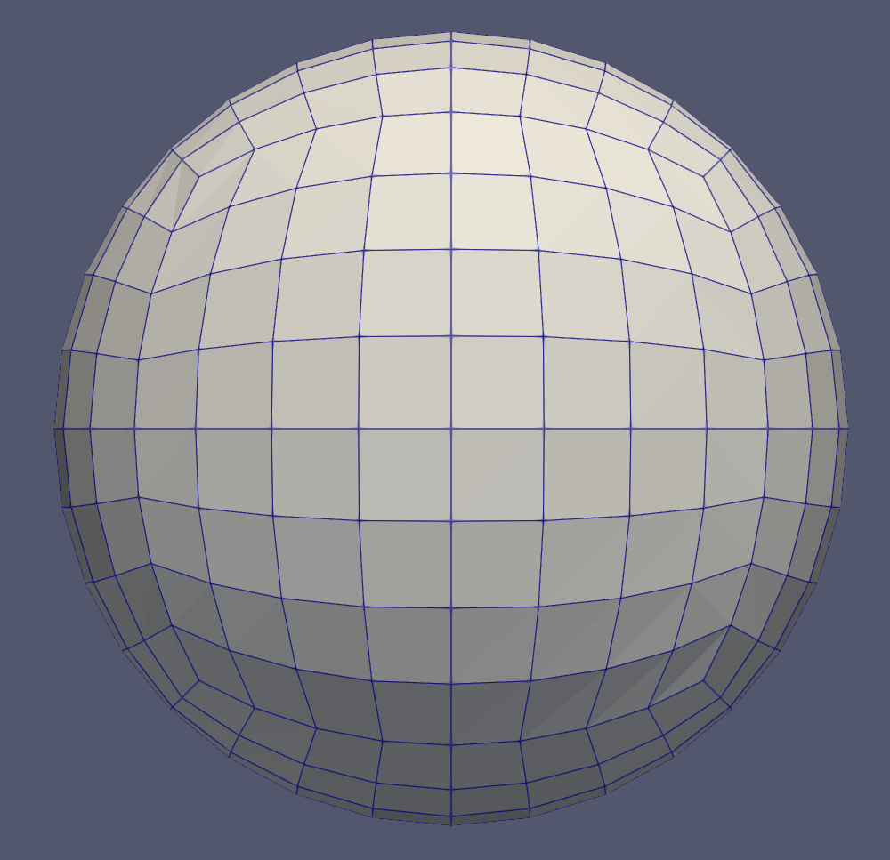
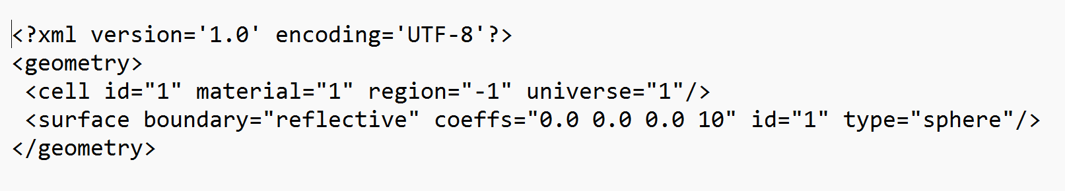
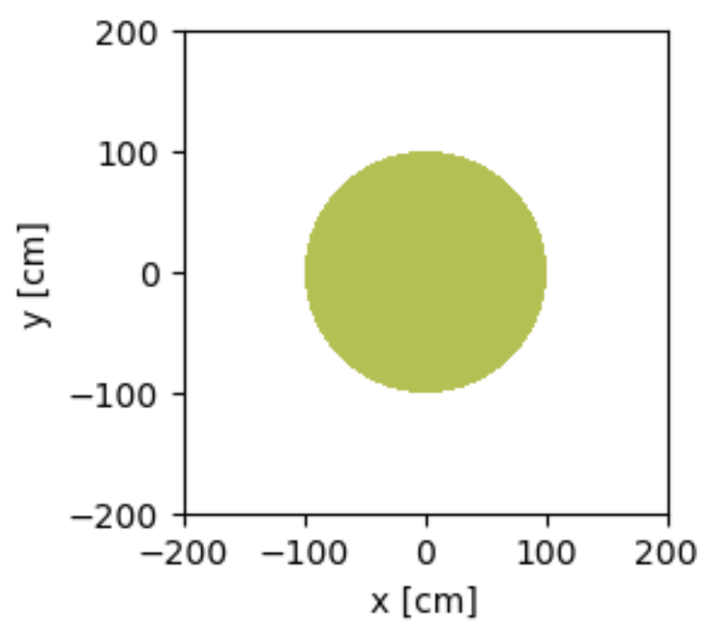
Current Progress

Slide 5
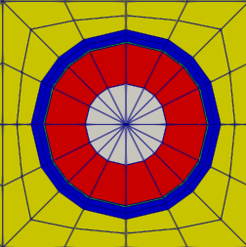
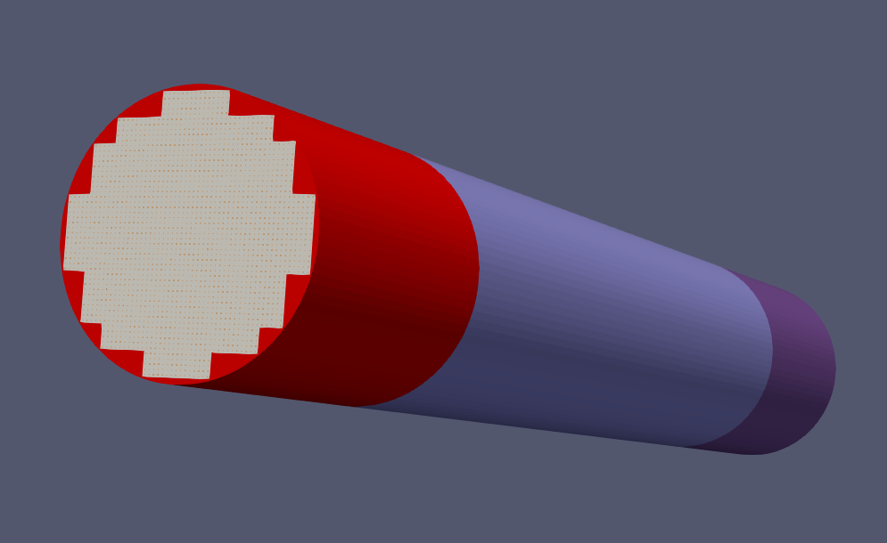
Future Work

